Slide 1
Java GUI with Swing (Part I)
Java – How to Program
By Deitel & Deitel
and
http://docs.oracle.com/javase/tutorial/uiswing/index.html

Slide 2
Swing and AWT
AWT (java.awt) and Swing (javax.swing)
AWT gives same look and Swing allows for different look
AWT is heavyweight and Swing is mostly lightweight

Slide 3

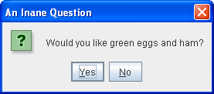

Top level container
JApplet | JDialog | JFrame

Slide 4
To appear on screen, every GUI component must be part of a containment hierarchy.
Each GUI component can be contained only once.
Each top-level container has a content pane that contains (directly or indirectly) the visible components in that top-level container's GUI.
You can optionally add a menu bar to a top-level container. The menu bar is by convention positioned within the top-level container, but outside the content pane.
Notes:
A containment hierarchy is a tree of components that has a top-level container as its root. We'll show you one in a bit.
If a component is already in a container and you try to add it to another container, the component will be removed from the first container and then added to the second.
Some look and feels, such as the Mac OS look and feel, give you the option of placing the menu bar in another place more appropriate for the look and feel, such as at the top of the screen.

Slide 5
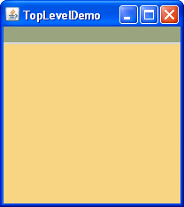
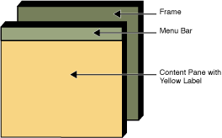
Frame
Menu Bar
Content Pane with a yellow label

Slide 6
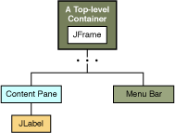

Slide 7
Top level containers
java.lang.Object
java.awt.Component
java.awt.Container
java.awt.Window
java.awt.Frame
javax.swing.JFrame

Slide 8
java.lang.Object
java.awt.Component
java.awt.Container
java.awt.Window
java.awt.Dialog
javax.swing.JDialog

Slide 9
java.lang.Object
java.awt.Component
java.awt.Container
java.awt.Panel
java.applet.Applet
javax.swing.JApplet

Slide 10
Swing Component hierarchy
java.lang.Object
java.awt.Component
java.awt.Container
javax.swing.JComponent

Slide 11
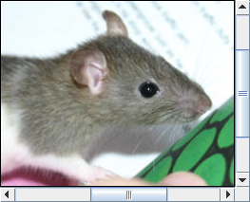

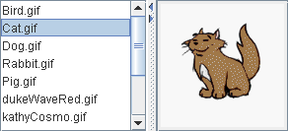


General purpose container
JPanel | JScrollPane
JSplitPane | JTabbedPane
JToolBar

Slide 12
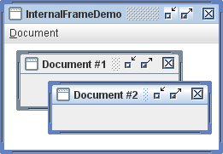
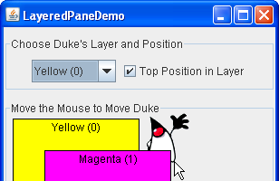
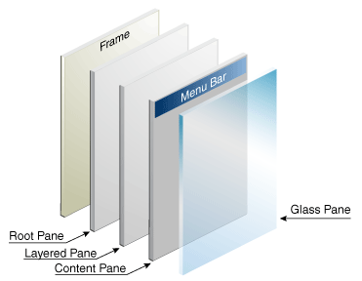
Special Purpose Container
JInternalFrame | JLayeredPane
Root pane

Slide 13

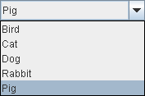

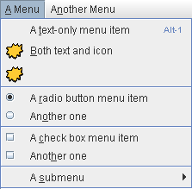
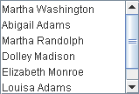
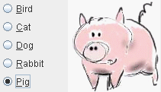
Basic Controls
JComboBox
JCheckBox
JButton
JMenu
JRadioButton
JList

Slide 14

JSlider
JSpinner
JTextField
JPasswordField

Slide 15
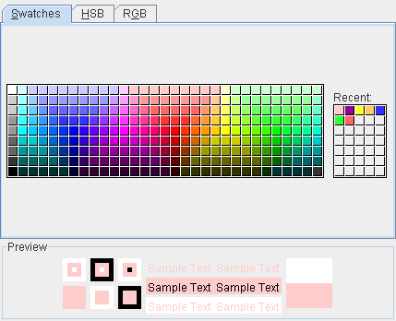
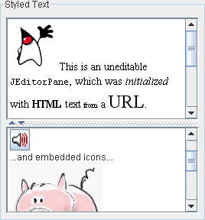
JColorChooser | JEditorPane and JTextPane

Slide 16
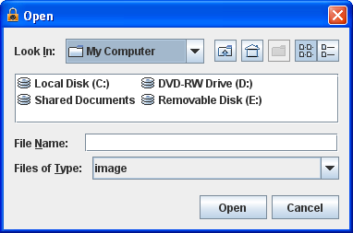
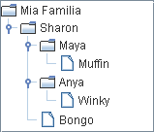
JTree
JFileChooser

Slide 17

JTable

Slide 18
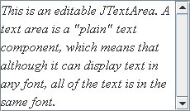
JTextArea

Slide 19
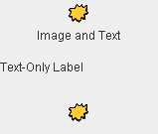
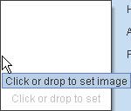
JLabel | JProgressBar | JSeparator | JToolTip

Slide 20
How to Make Frames (Main Windows)

Slide 21
What is Frame?
is a top-level window with a title and a border.
The size of the frame includes any area designated for the border.
Applications with a GUI typically use at least one frame.

Slide 22
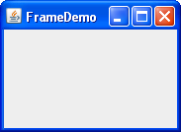
Creating and Showing Frames
import java.awt.*;
import java.awt.event.*;
import javax.swing.*;
/* FrameDemo.java requires no other files. */
public class FrameDemo {
… ..
public static void main(String[] args) {
//Create and set up the window.
JFrame frame = new JFrame("FrameDemo");
frame.setDefaultCloseOperation(JFrame.EXIT_ON_CLOSE);
… …
//Display the window.
frame.pack();
frame.setVisible(true);
}
… …
}

Slide 23
The Frame API
Creating and Setting Up a Frame
Setting the Window Size and Location
Methods Related to the Root Pane

Slide 24
Creating and Setting Up a Frame
JFrame() JFrame(String) setVisible(bool) | Create a frame that is initially invisible. The String argument provides a title for the frame. To make the frame visible, invoke setVisible(true) on it.

Slide 25
void setDefaultCloseOperation(int) int getDefaultCloseOperation() | Set or get operation that occurs when the user pushes the close button on this frame. Possible choices are: DO_NOTHING_ON_CLOSE HIDE_ON_CLOSE DISPOSE_ON_CLOSE EXIT_ON_CLOSE

Slide 26
void setIconImage(Image) Image getIconImage() | Set or get the icon that represents the frame. Note that the argument is a java.awt.Image object, not a javax.swing.ImageIcon (or any other javax.swing.Icon implementation).

Slide 27
void setTitle(String) String getTitle() (in Frame) | Set or get the frame's title.

Slide 28
Setting Window Size & Location
void pack() (in Window) | Size the window so that all its contents are at or above their preferred sizes.

Slide 29
void setSize(int, int) void setSize(Dimension) Dimension getSize() (in Component) | Set or get the total size of the window. The integer arguments to setSize specify the width and height, respectively.

Slide 30
void setBounds(int, int, int, int) void setBounds(Rectangle) Rectangle getBounds() (in Component) | Set or get the size and position of the window. For the integer version of setBounds, the window's upper left corner is at the x, y location specified by the first two arguments, and has the width and height specified by the last two arguments.

Slide 31
void setLocation(int, int) Point getLocation() (in Component) | Set or get the location of the upper left corner of the window. The parameters are the x and y values, respectively.

Slide 32
void setLocationRelativeTo(Component) (in Window) | Position the window so that it's centered over the specified component. If the argument is null, the window is centered on screen. To properly center the window, you should invoke this method after the window's size has been set.

Slide 33
How to Use Buttons, Check Boxes, and Radio Buttons

Slide 34
java.lang.Object
java.awt.Component
java.awt.Container javax.swing.JComponent javax.swing.AbstractButton

Slide 35
Class Summary
JButton A common button.
JCheckBox A check box button.
JRadioButton One of a group of radio buttons.
JMenuItem An item in a menu.
JCheckBoxMenuItem A menu item that has a check box.
JRadioButtonMenuItem A menu item that has a radio button.
JToggleButton Implements toggle functionality inherited by JCheckBox and JRadioButton.

Slide 36
Basic Controls
JComboBox
JCheckBox
JButton
JMenu
JRadioButton
JList

Slide 37

How to use common button

Slide 38
import javax.swing.AbstractButton;
import javax.swing.JButton;
import javax.swing.JPanel;
import javax.swing.ImageIcon;
/*
* ButtonDemo.java requires the following files:
* images/right.gif
* images/middle.gif
* images/left.gif
*/
public class ButtonDemo extends JPanel {
protected JButton b1, b2, b3;

Slide 39
public ButtonDemo() {
ImageIcon leftButtonIcon = createImageIcon("images/right.gif");
ImageIcon middleButtonIcon = createImageIcon("images/middle.gif");
ImageIcon rightButtonIcon = createImageIcon("images/left.gif");
b1 = new JButton("Disable middle button", leftButtonIcon);
b1.setVerticalTextPosition(AbstractButton.CENTER);
b1.setHorizontalTextPosition(AbstractButton.LEADING); //aka LEFT, for left-to-right locales
b2 = new JButton("Middle button", middleButtonIcon);
b2.setVerticalTextPosition(AbstractButton.BOTTOM);
b2.setHorizontalTextPosition(AbstractButton.CENTER);
b3 = new JButton("Enable middle button", rightButtonIcon);
b3.setVerticalTextPosition(AbstractButton.CENTER);
b3.setHorizontalTextPosition(AbstractButton.TRAILING);
b3.setEnabled(false); // disable button
b1.setToolTipText("Click this button to disable the middle button.");
b2.setToolTipText("This middle button does nothing when you click it.");
b3.setToolTipText("Click this button to enable the middle button.");
//Add Components to this container, using the default FlowLayout.
add(b1);
add(b2);
add(b3);
}

Slide 40
/** Returns an ImageIcon, or null if the path was invalid. */
protected static ImageIcon createImageIcon(String path) {
java.net.URL imgURL = ButtonDemo.class.getResource(path);
if (imgURL != null) {
return new ImageIcon(imgURL);
} else {
System.err.println("Couldn't find file: " + path);
return null;
}
}
}

Slide 41
import javax.swing.JFrame;
public class ButtonDemoTest{
public static void main(String args[]){
//Create and set up the window.
JFrame frame = new JFrame("TopLevelDemo");
frame.setDefaultCloseOperation(JFrame.EXIT_ON_CLOSE);
//Create and set up the content pane.
ButtonDemo newContentPane = new ButtonDemo();
newContentPane.setOpaque(true); //content panes must be opaque
frame.setContentPane(newContentPane);
//Display the window.
frame.pack();
frame.setVisible(true);
}
}

Slide 42
Introduction to Event Handling

Slide 43
《interface》
Subject
registerObserver()
removeObserver()
notifyObserver()
《interface》
Observer
update()
ConcreteSubject
registerObserver(){…}
removeObserver(){…}
notifyObserver(){…}
getState()
setState()
ConcreteObserver
update(){…}
// other methods

Slide 44
Java Event Handling Example
Name in Design Pattern | Actual Name in JButton Event Handling
Subject | JButton
Observer | ActionListener
ConcreteObserver | The class that implements ActionListener interface
Attach() | addActionListener
Notify() | actionPerformed

Slide 45
Basic concepts
Event
When users interact with a GUI component, the interaction is called event
Events drive the program to perform a task
Event source
the GUI component on which the event occurs
Event handler (listener)
The code that performs a task in response to an event
Event set up
The process of creating event handler class/object and registering the handler with event source
Event handling
The overall process of setting up event handling and responding to events

Slide 46
Event handling process
Event set up
Programmer write code to implement the event handler and register the event handler with a GUI component
Event handling
Java VM and GUI component works together responding to events

Slide 47
Set up Event Handling
Create an event handler (listener) class
The event handler class implements an appropriate event-listener interface.
2. Create an object of the above event handler class
3. Registering the event handler object with the event source (GUI component)
i.e., when event occurs, a registered object of the event handler class will be notified.

Slide 48
GUI object
(plainJButton=new JButton();)
Event Type
(ActionEvent)
Event handler
Interface
(ActionListener)
Class ButtonHandler implements
ActionListener{
….
Public void actionPerformed(…){
}
….
}
listenerList
Event handler
class
handler = new
ButtonHandler();
Event handler
object
plainJButton.addActionListener (handler);
Add handler object to the event listener list of GUI object

Slide 49
Event Handling (delegation event model)
When an event occurs, Java VM sent event object to GUI component
The event object contains
- event source, event type, and event id, etc
3. When GUI component receives event object
Identify the registered handler based on event type
Identify the specific method for the registered handler based on event id
Call the specific method to handle the event

Slide 50
Event Types & Listener Interfaces
Many different types of events
They are specified in java.awt.event
Event types specific to Swing are specified in javax.swing.event
For each event type, there is one or more corresponding event-listener interface
For each listener interface, there is one or more event handling methods.

Slide 51
Action Event and Action Listener
You implement an action listener to define what should be done when an user performs certain operation.
An action event occurs, whenever an action is performed by the user.
- clicks a button,
- chooses a menu item,
- presses Enter in a text field.
When an action event occurs, JMV sends an ActionEvent class object to event source.

Slide 52
ActionEvent Class
String getActionCommand()
Returns the string associated with this action. Most objects that can fire action events support a method called setActionCommand that lets you set this string.
int getModifiers()
Returns an integer representing the modifier keys the user was pressing when the action event occurred.
You can use the ActionEvent-defined constants SHIFT_MASK, CTRL_MASK, META_MASK, and ALT_MASK to determine which keys were pressed.
For example, if the user Shift-selects a menu item, then the following expression is nonzero:
actionEvent.getModifiers() & ActionEvent.SHIFT_MASK
Object getSource() (in java.util.EventObject) Returns the object that fires the event.

Slide 53
ActionListener Interface
public void actionPerformed(ActionEvent e) { ...
//code that reacts to the action...
}

Slide 54
Write an Action Listener:
Declare an event handler class
class either implements an ActionListener interface or
extends a class that implements an ActionListener interface.
public class MyClass implements ActionListener {
… …
public void actionPerformed(ActionEvent e) { ...
//code that reacts to the action...
}
}
Register an instance of the event handler class on one or more components.
someComponent.addActionListener(instanceOfMyClass);

Slide 55
Event handling with Nested Classes

Slide 56
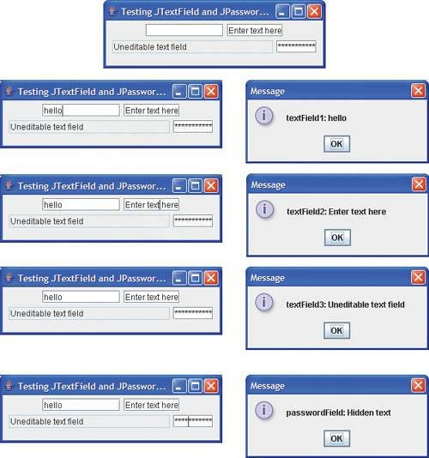

Slide 57
// Fig. 11.9: TextFieldFrame.java
// Demonstrating the JTextField class.
import java.awt.FlowLayout;
import java.awt.event.ActionListener;
import java.awt.event.ActionEvent;
import javax.swing.JFrame;
import javax.swing.JTextField;
import javax.swing.JPasswordField;
import javax.swing.JOptionPane;
public class TextFieldFrame extends JFrame
{
private JTextField textField1; // text field with set size
private JTextField textField2; // text field constructed with text
private JTextField textField3; // text field with text and size
private JPasswordField passwordField; // password field with text

Slide 58
// TextFieldFrame constructor adds JTextFields to JFrame
public TextFieldFrame()
{
super( "Testing JTextField and JPasswordField" );
setLayout( new FlowLayout() ); // set frame layout
// construct textfield with 10 columns
textField1 = new JTextField( 10 );
add( textField1 ); // add textField1 to JFrame
// construct textfield with default text
textField2 = new JTextField( "Enter text here" );
add( textField2 ); // add textField2 to JFrame
// construct textfield with default text and 21 columns
textField3 = new JTextField( "Uneditable text field", 21 );
textField3.setEditable( false ); // disable editing
add( textField3 ); // add textField3 to JFrame
// construct passwordfield with default text
passwordField = new JPasswordField( "Hidden text" );
add(passwordField ); // add passwordField to JFrame

Slide 59
// create and register event handlers
TextFieldHandler handler = new TextFieldHandler();
// create and register event handlers
textField1.addActionListener( handler );
textField2.addActionListener( handler );
textField3.addActionListener( handler );
passwordField.addActionListener( handler );
} // end TextFieldFrame constructor

Slide 60
// private inner class for event handling
private class TextFieldHandler implements ActionListener
{
// process textfield events
public void actionPerformed( ActionEvent event )
{
String string = ""; // declare string to display
// user pressed Enter in JTextField textField1
if ( event.getSource() == textField1 )
string = String.format( "textField1: %s",
event.getActionCommand() );
// user pressed Enter in JTextField textField2
else if ( event.getSource() == textField2 )
string = String.format( "textField2: %s",
event.getActionCommand() );
// user pressed Enter in JTextField textField3
else if ( event.getSource() == textField3 )
string = String.format( "textField3: %s",
event.getActionCommand() );
// user pressed Enter in JTextField passwordField
else if ( event.getSource() == passwordField )
string = String.format( "passwordField: %s",
new String( passwordField.getPassword() ) );
// display JTextField content
JOptionPane.showMessageDialog( null, string );
} // end method actionPerformed
} // end private inner class TextFieldHandler

Slide 61
} // end class TextFieldFrame
// Fig. 11.10: TextFieldTest.java
// Testing TextFieldFrame.
import javax.swing.JFrame;
public class TextFieldTest
{
public static void main( String args[] )
{
TextFieldFrame textFieldFrame = new TextFieldFrame();
textFieldFrame.setDefaultCloseOperation( JFrame.EXIT_ON_CLOSE );
textFieldFrame.setSize( 325, 100 ); // set frame size
textFieldFrame.setVisible( true ); // display frame
} // end main
} // end class TextFieldTest

Slide 62
Event handling with Anonymous Inner Class

Slide 63
public class ButtonFrame extends JFrame
{
private JButton plainJButton; // button with just text
// ButtonFrame adds JButtons to JFrame
public ButtonFrame()
{
super( "Testing Buttons" );
setLayout( new FlowLayout() ); // set frame layout
plainJButton = new JButton( "Plain Button" ); // button with text
add( plainJButton ); // add plainJButton to JFrame
// create new ButtonHandler for button event handling
ButtonHandler handler = new ButtonHandler();
plainJButton.addActionListener( handler );
} // end ButtonFrame constructor
// inner class for button event handling
private class ButtonHandler implements ActionListener
{
// handle button event
public void actionPerformed( ActionEvent event )
{
JOptionPane.showMessageDialog( ButtonFrame.this, String.format(
"You pressed: %s", event.getActionCommand() ) );
} // end method actionPerformed
} // end private inner class ButtonHandler
} // end class ButtonFrame

Slide 64
public class ButtonFrame extends JFrame
{
private JButton plainJButton; // button with just text
// ButtonFrame adds JButtons to JFrame
public ButtonFrame()
{
super( "Testing Buttons" );
setLayout( new FlowLayout() ); // set frame layout
plainJButton = new JButton( "Plain Button" ); // button with text
add( plainJButton ); // add plainJButton to JFrame
//Use anonymous inner class
plainJButton.addActionListener(
new ActionListener () // anonymous inner class
{
// handle button event
public void actionPerformed( ActionEvent event )
{
JOptionPane.showMessageDialog( ButtonFrame.this, String.format("You pressed: %s", event.getActionCommand() ) );
} // end method actionPerformed
} // end of anonymous inner class
); // end of add
} // end ButtonFrame constructor
} // end class ButtonFrame

